Slide 1
Employee Data Analysis using Excel
STUDENT NAME : VAHITHA I
REGISTER NO : 312215102 (asunm1485312215102)
DEPARTMENT : Commerce
COLLEGE : soka ikeda arts and science college for
women

Slide 2
PROJECT TITLE
Employee Performance Analysis using Excel

Slide 3


AGENDA
Problem Statement
Project Overview
End Users
Our Solution and Proposition
Dataset Description
Modelling Approach
Results and Discussion
Conclusion
3/21/2024 Annual Review

Slide 4

PROBLEM STATEMENT
The company seeks to enhance its workforce productivity by identifying performance trends and areas for improvement among employees. Currently, there is no systematic approach to evaluate employee performance comprehensively. The objective is to develop an Excel-based performance analysis tool that consolidates employee performance data, allows for the evaluation of key performance indicators (KPIs), and provides actionable insights to support management decisions.​ ​ ​

Slide 5
PROJECT OVERVIEW
The Information and Communications Technology (ICT) industry, employee performance is of great importance because it impacts both business efficiency and customer satisfaction. Many different performance measures have been proposed in the past, but there is still no universal benchmarking method that can be adopted by all businesses. This may present a challenge however since it may be harder to measure employee performance in this context. One of the biggest reasons is the complexity of technological products and projects. Developing a technological product or service is a complex process that involves many different variables, including technical skills, communication skills, and project management. Measuring performance across all of these variables can be difficult, especially given the different roles and responsibilities that engineers may have within an organization​

Slide 6

WHO ARE THE END USERS?
HR Managers: To assess and manage employee performance and development needs.​ Department Heads: To identify high performers and areas where additional training or support might be required.​ Executives: For strategic planning and overall organizational performance insights.​

Slide 7

OUR SOLUTION AND ITS VALUE PROPOSITION
Dashboard Creation: Develop interactive dashboards in Excel to provide a visual overview of employee performance.​ Performance Metrics: Use Excel formulas to calculate key metrics such as productivity, attendance, and achievement of goals.​ Data Visualization: Implement charts and graphs to represent data trends and comparisons effectively​

Slide 8
Dataset Description
Employee Information: Names, roles, departments, and tenure.​
Performance Metrics: KPIs such as sales numbers, project completion rates, customer feedback scores, etc.​
Historical Data: Past performance data to enable trend analysis.​
Qualitative Feedback: Supervisor comments and peer reviews, if available.​

Slide 9
MODELLING
Data Preparation: Cleaning and organizing data for accuracy and consistency.​ Descriptive Analysis: Using Excel functions (e.g., AVERAGE, MEDIAN) to summarize performance.​ Trend Analysis: Employing Excel charts and pivot tables to visualize performance over time.​ Comparative Analysis: Using formulas and conditional formatting to compare performance across different groups.​ Predictive Modeling: If applicable, utilizing Excel’s regression tools to forecast future performance trends​
9

Slide 10
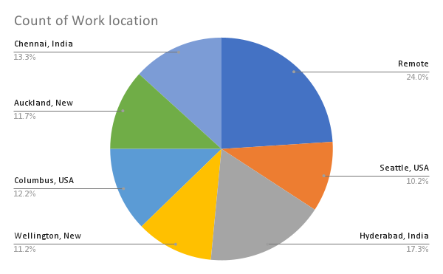
RESULTS
10

Slide 11
conclusion
Summary of Insights: Recap of the main findings from the performance analysis.​ Implications: How these insights impact decision-making and strategy.​ Recommendations: Suggested actions based on the analysis (e.g., training programs, performance incentives).​ Future Work: Areas for further analysis or improvement in the data collection and analysis process.​

